Slide 1
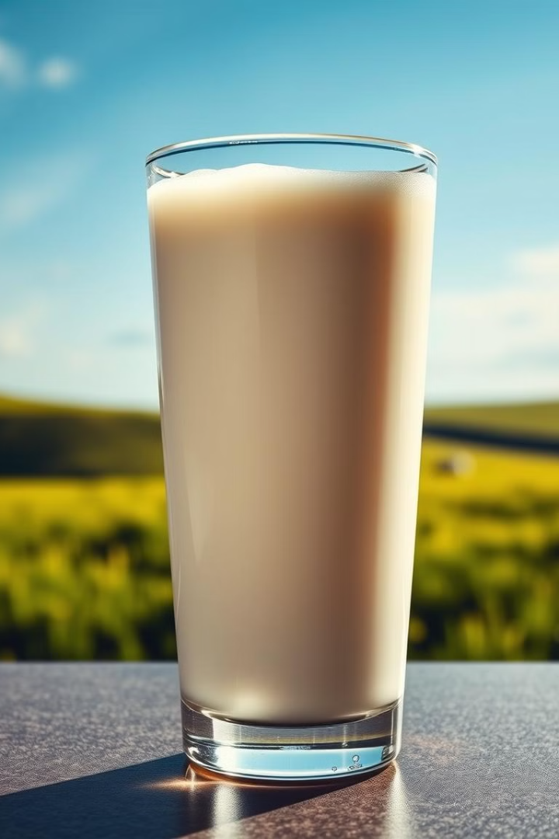
Milk Quality Prediction Using Machine Learning
This project outlines a comprehensive approach to predicting milk quality using machine learning which includes identifying factors that influence milk quality like pH, Temperature, Odor, etc.
by Chirayu Randhir

Slide 2
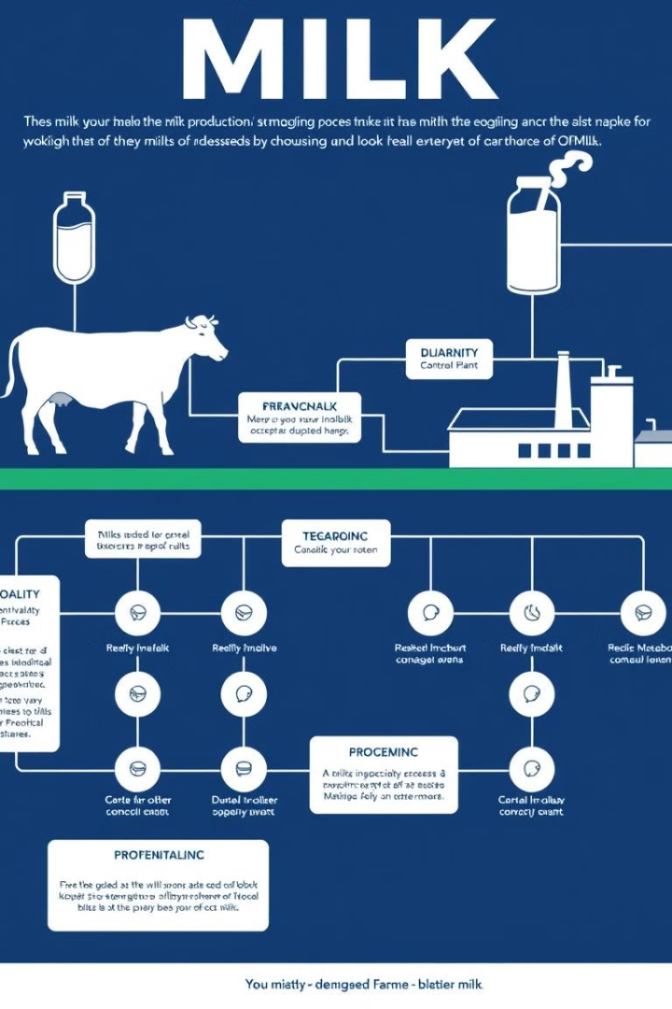
Problem Statement
Milk quality is crucial for ensuring consumer safety and satisfaction. This project aims to develop a machine learning model to predict milk quality based on various parameters, facilitating early detection of potential issues and optimizing production processes.
1
Objective
2
Data
Develop a robust model to accurately classify milk quality into high, medium, and low categories.
The dataset comprises various milk attributes, including pH, temperature, taste, odor, fat content, turbidity, color, and grade.
3
Challenges
Dealing with multiclass classification, outlier detection, and feature engineering for optimal model performance.

Slide 3
Exploratory Data Analysis
The initial step involves understanding the data distribution and relationships between variables. This provides valuable insights into the data characteristics and potential predictors of milk quality.
Data Overview
Univariate Analysis
Bivariate Analysis
Analyzing data types, missing values, and basic statistics to gain an initial understanding of the data.
Exploring individual attributes using histograms, box plots, and frequency distributions to understand their characteristics.
Investigating relationships between pairs of attributes using scatter plots and correlation analysis to identify potential dependencies.

Slide 4

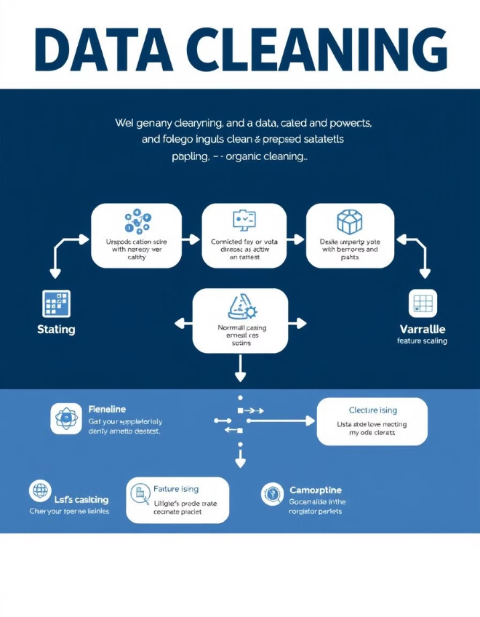
Data Preprocessing
Before applying machine learning models, data preprocessing is essential to ensure consistency and optimize model performance. This involves addressing missing values, handling outliers, and scaling features.
1
Missing Value Imputation
Filling in missing values using appropriate methods such as mean, median, or mode imputation based on data characteristics.
2
Outlier Detection
Identifying and addressing outliers using techniques like box plots, z-scores, or interquartile range to handle extreme values.
3
Feature Scaling
Normalizing or standardizing features to ensure that all variables have a similar scale, improving model performance.

Slide 5



Model Selection
(Decision Tree, Random Forest)
Machine learning models are employed to predict milk quality based on the extracted features. Decision trees and random forests are powerful algorithms suitable for multiclass classification.
Decision Tree
Random Forest
A simple and interpretable model that uses a series of rules to classify data points.
An ensemble method that combines multiple decision trees to improve prediction accuracy and reduce overfitting.

Slide 6
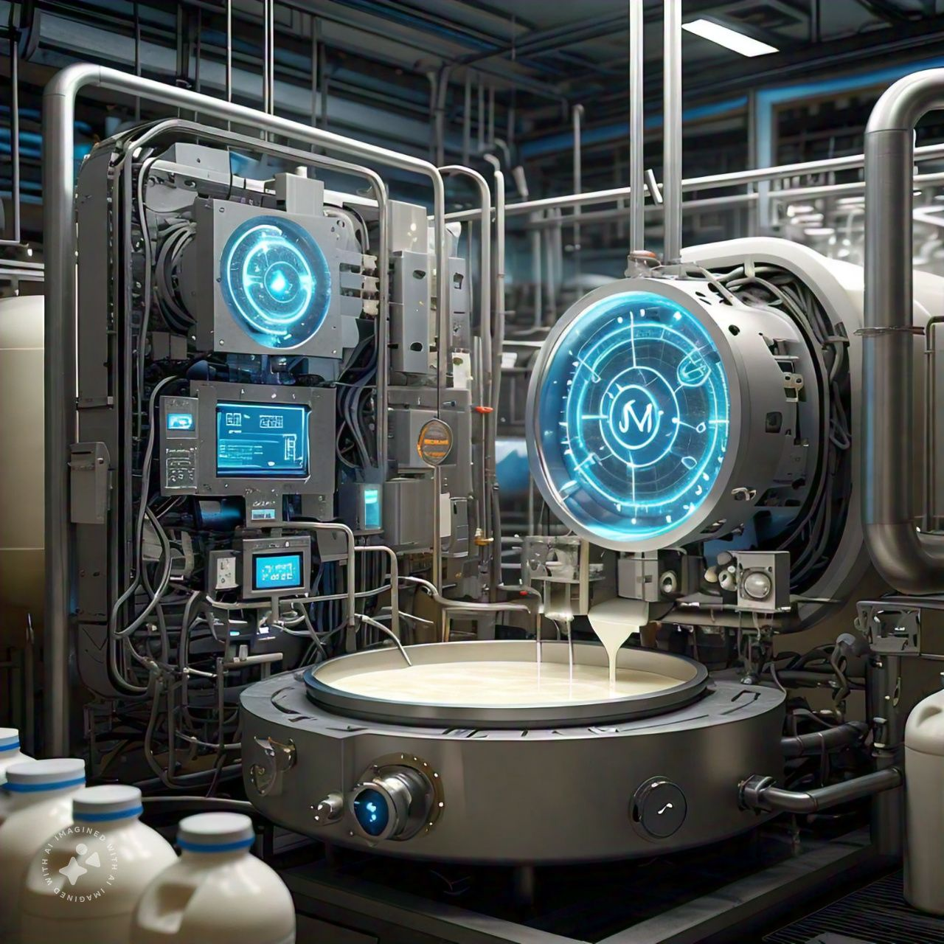


Conclusion and Future Works
In this project, we successfully developed a machine learning model using Random Forest and Decision Tree algorithms to predict milk quality with a similar accuracy. We achieved 87.73% accuracy for Decision Tree and 86.79% accuracy for Random Forest.
Additional Data Sources
Integrating additional data sources (e.g. sensor data, weather patterns)
Deployment in real-world
Deploying the model in a real-world dairy processing setting

